Slide 1
Implementing a data warehouse using SQL Database engine

Slide 2
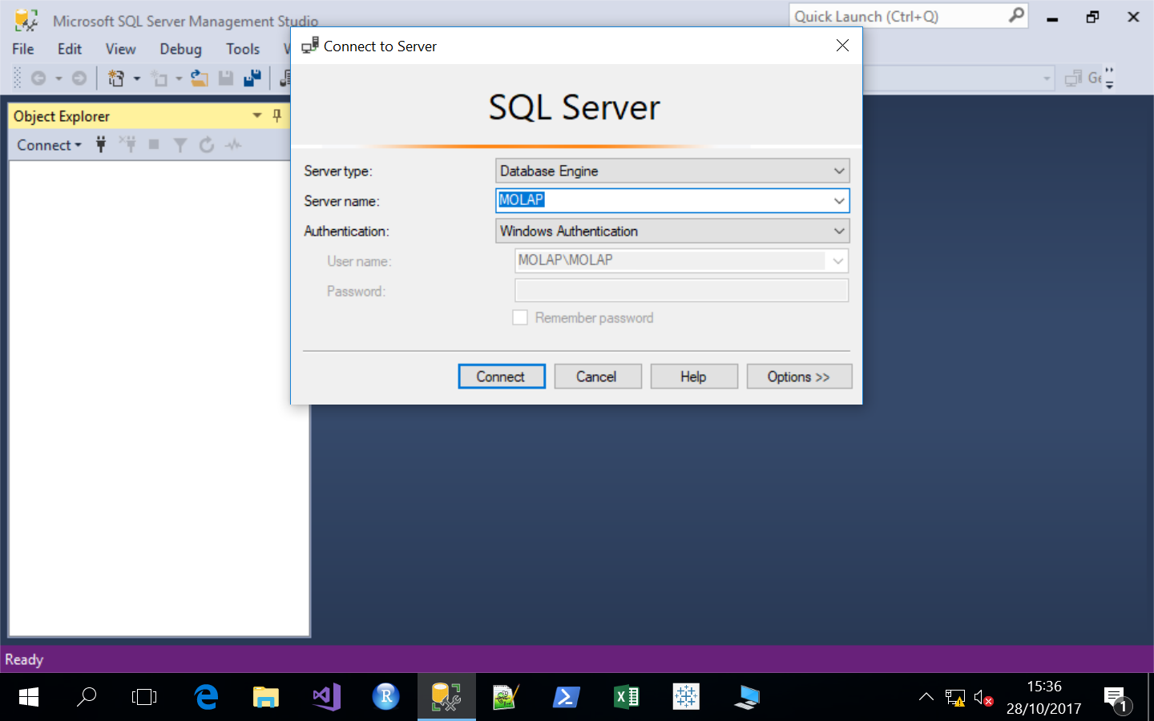
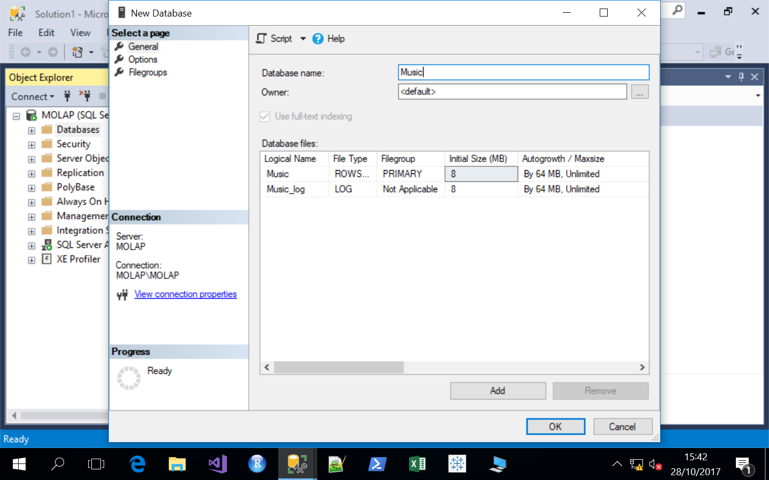
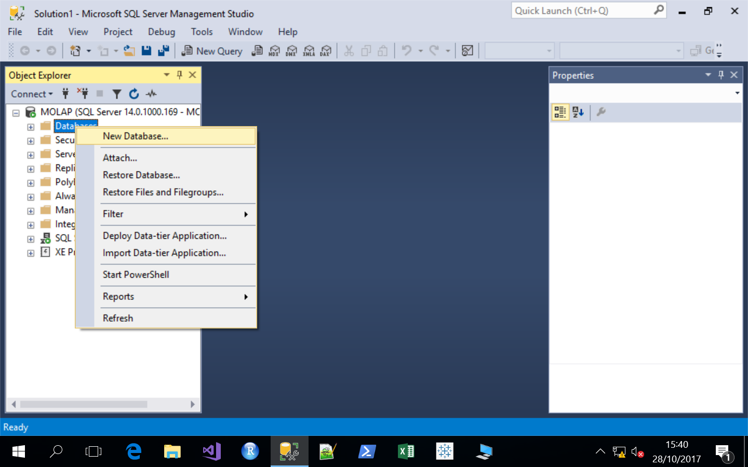
Create database in SQL Server Management Studio
1. Open SSMS > Click Connect
3. Enter Database name > Music
> Click OK
2. Right Click on Databases > Click New

Slide 3
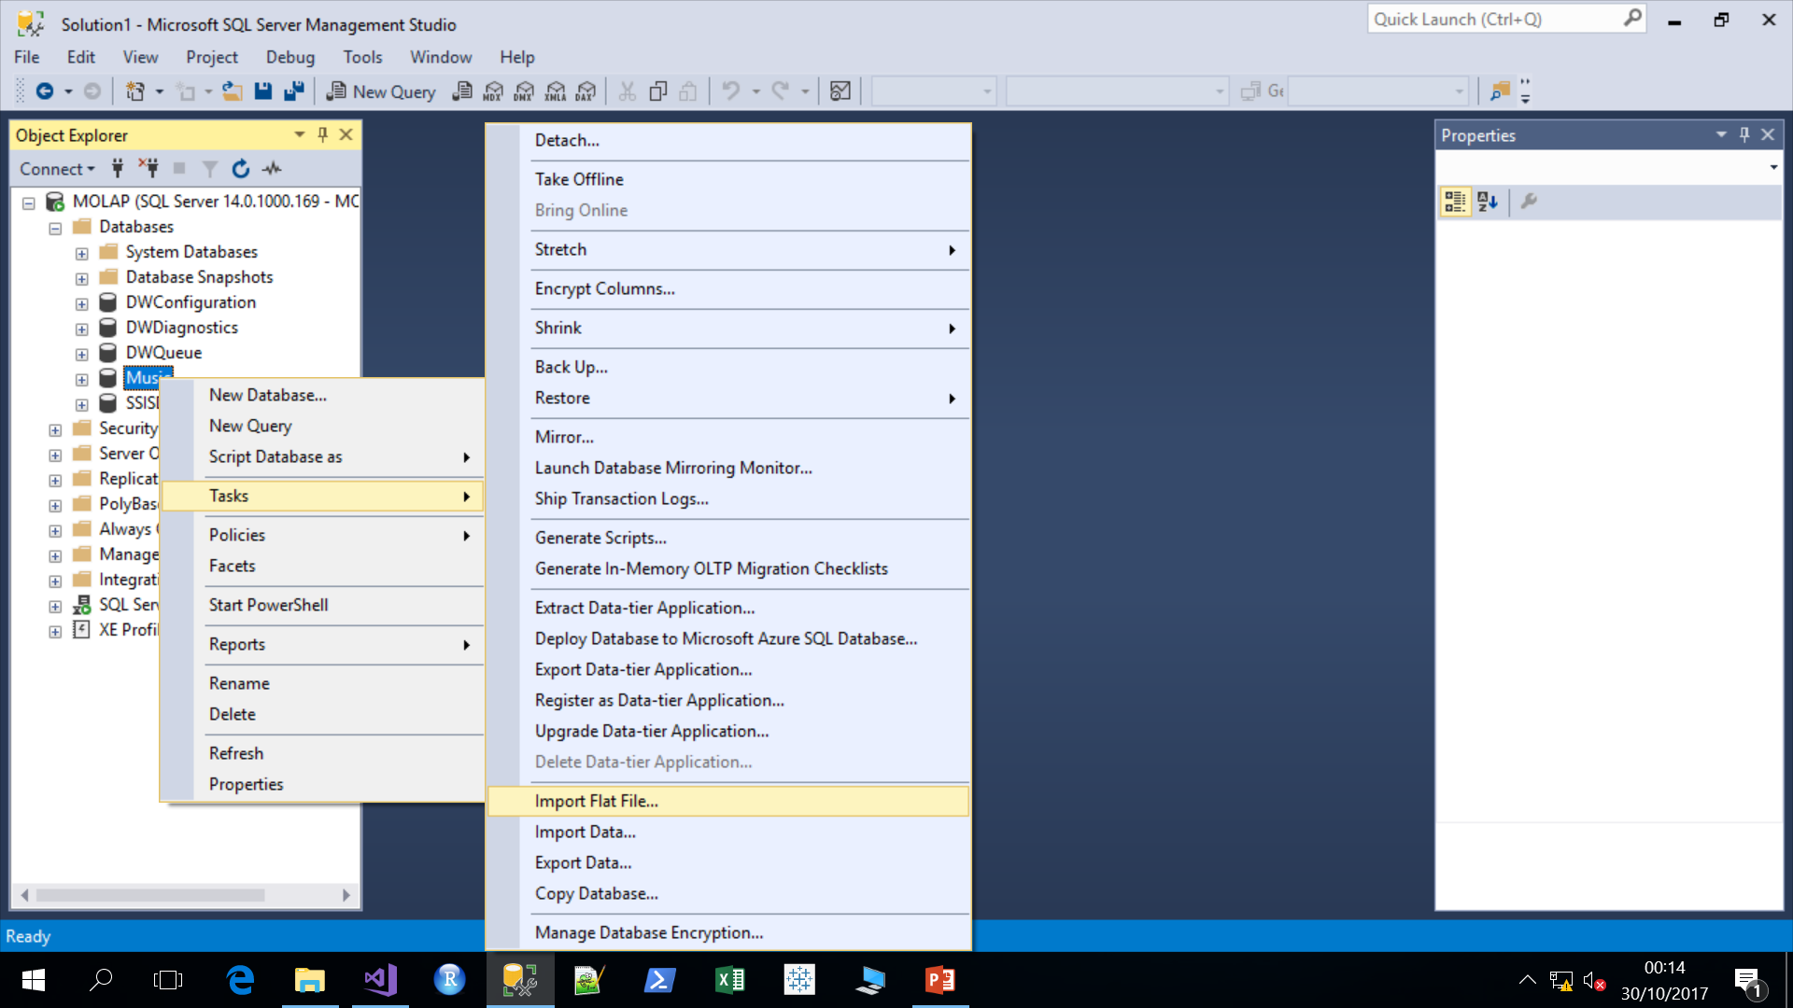
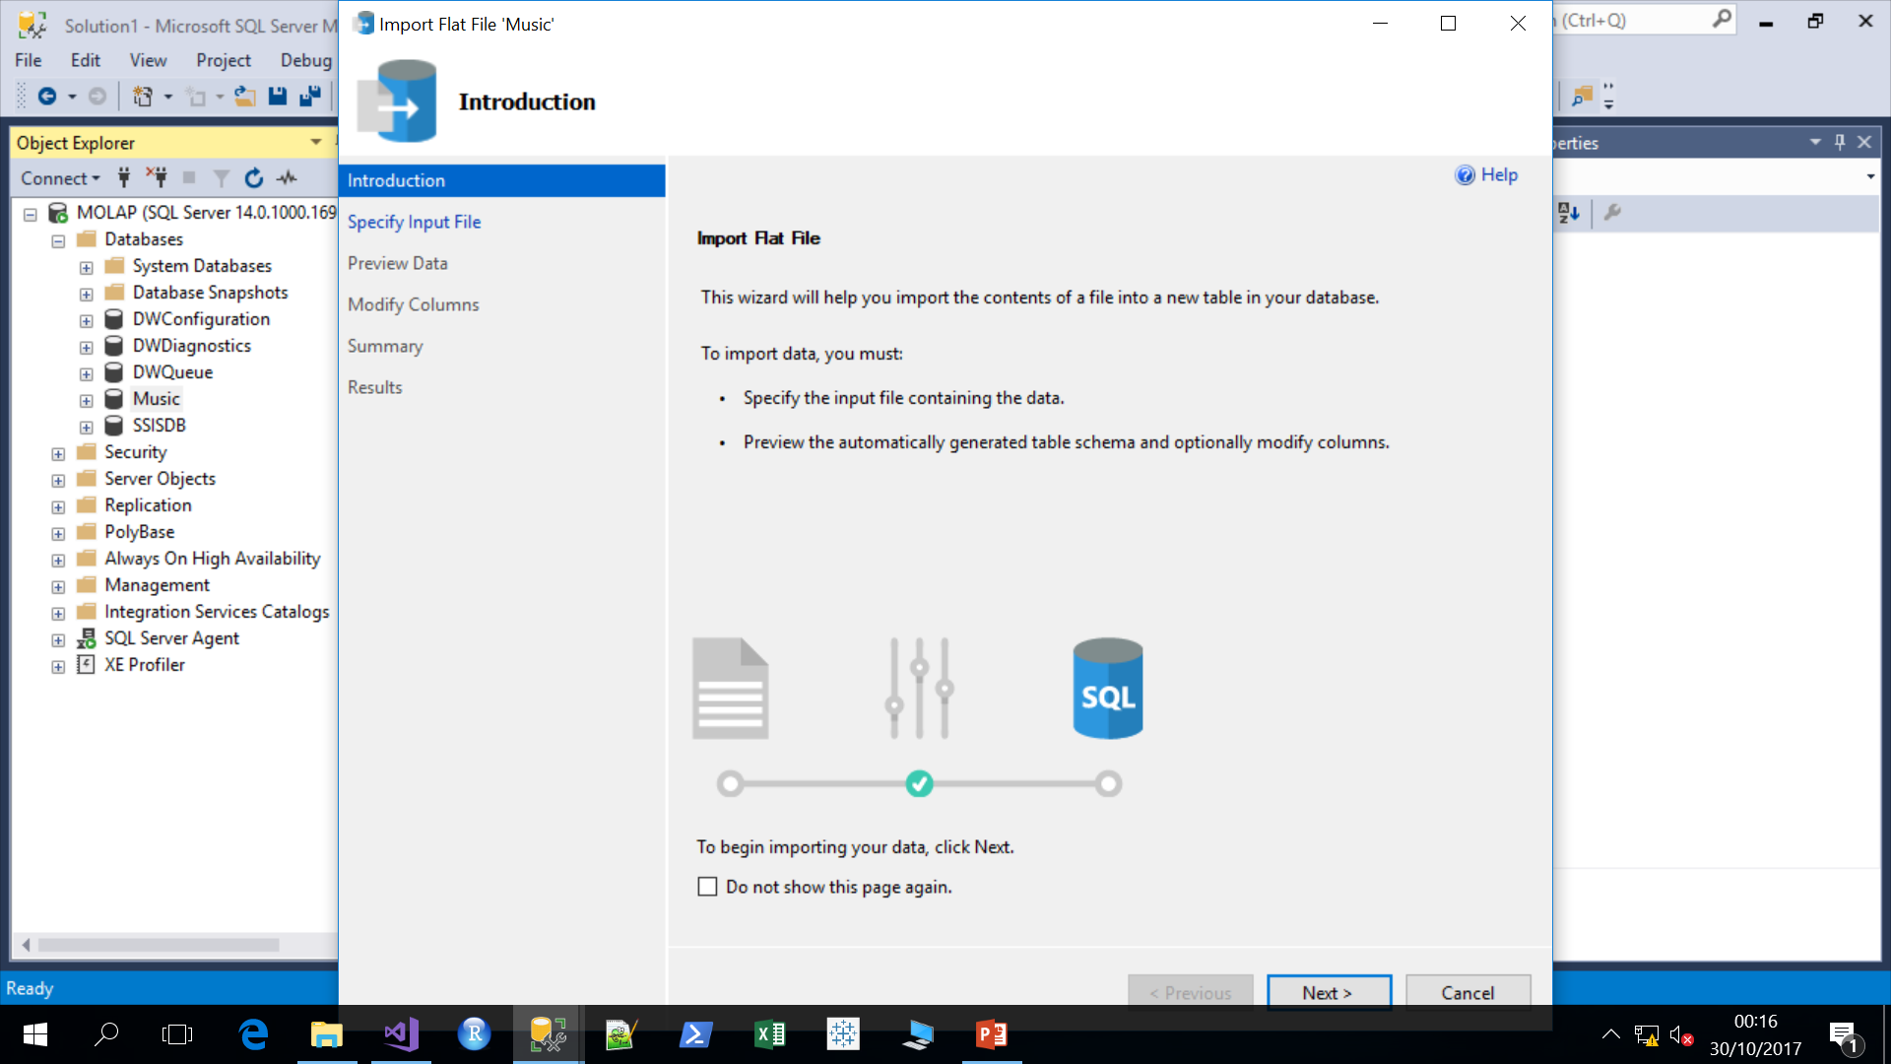
Upload data using SQL Server Management Studio
4. Right Click on Database > Tasks > Import Flat File
5. Click Next
Click here for Data Source

Slide 4
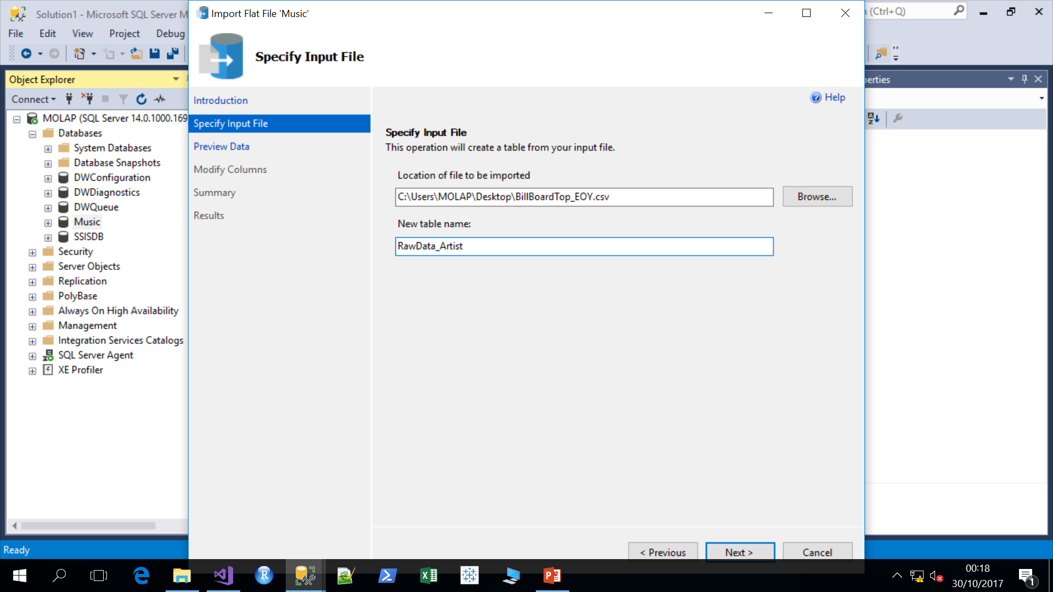
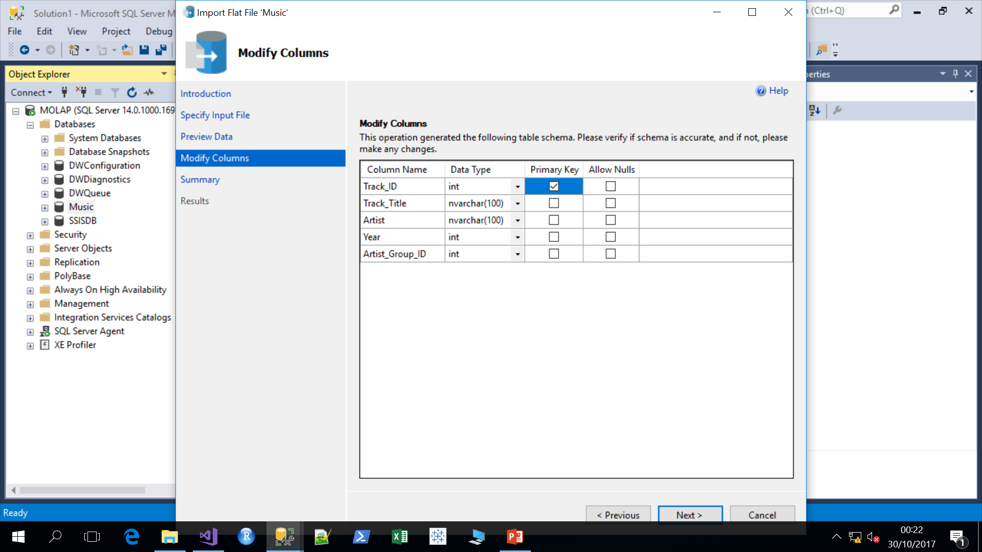
Upload data using SQL Server Management Studio Cont..
6. Browse file location > Rename table name
As ‘RawData_Artist’ > Next
7. Preview rows & Click Next > Check Primary Key
> Next > Finish > Close

Slide 5
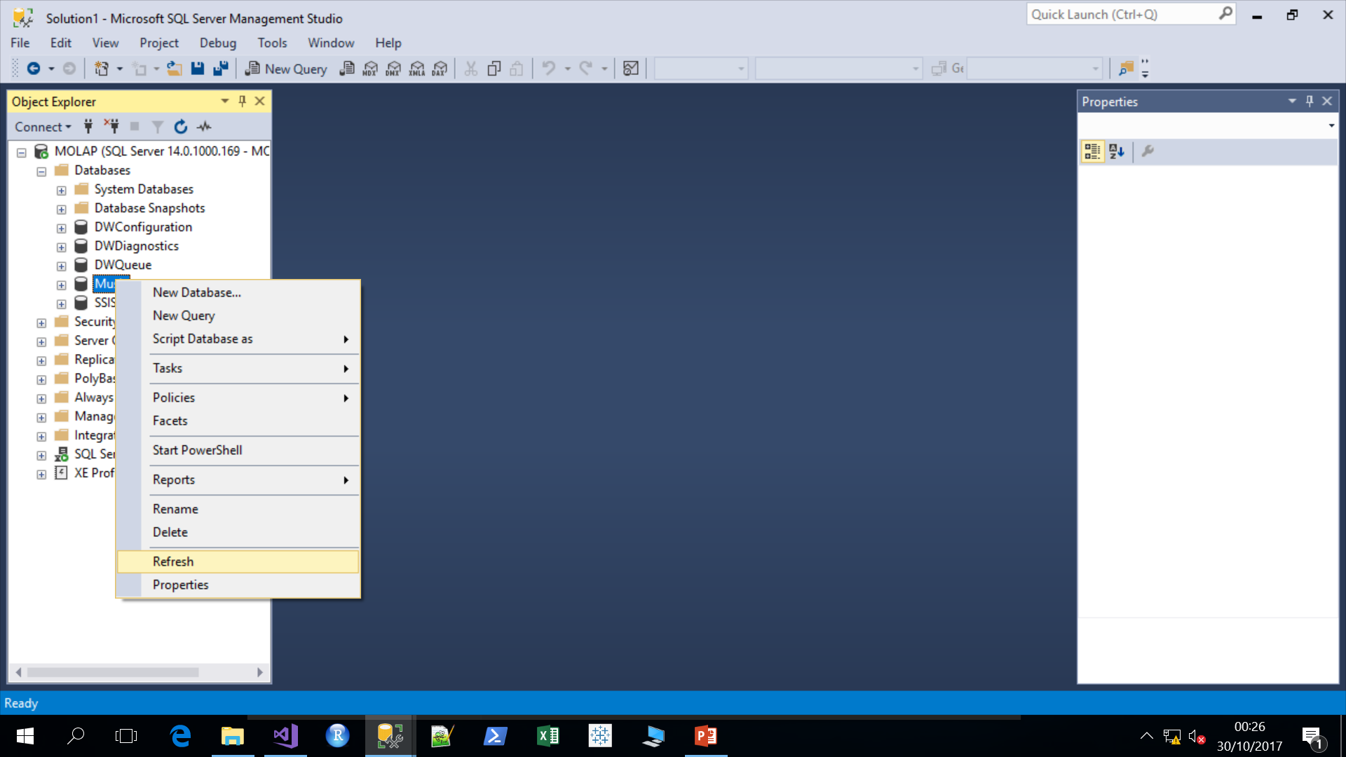
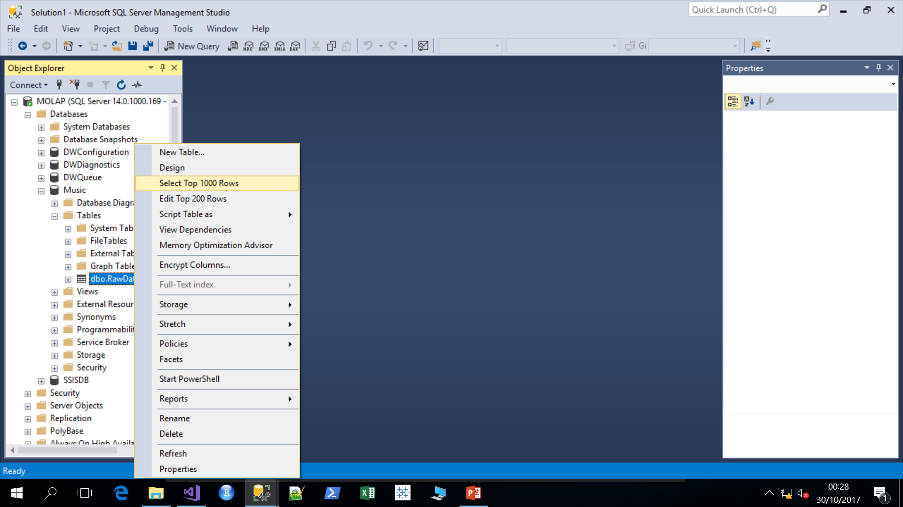
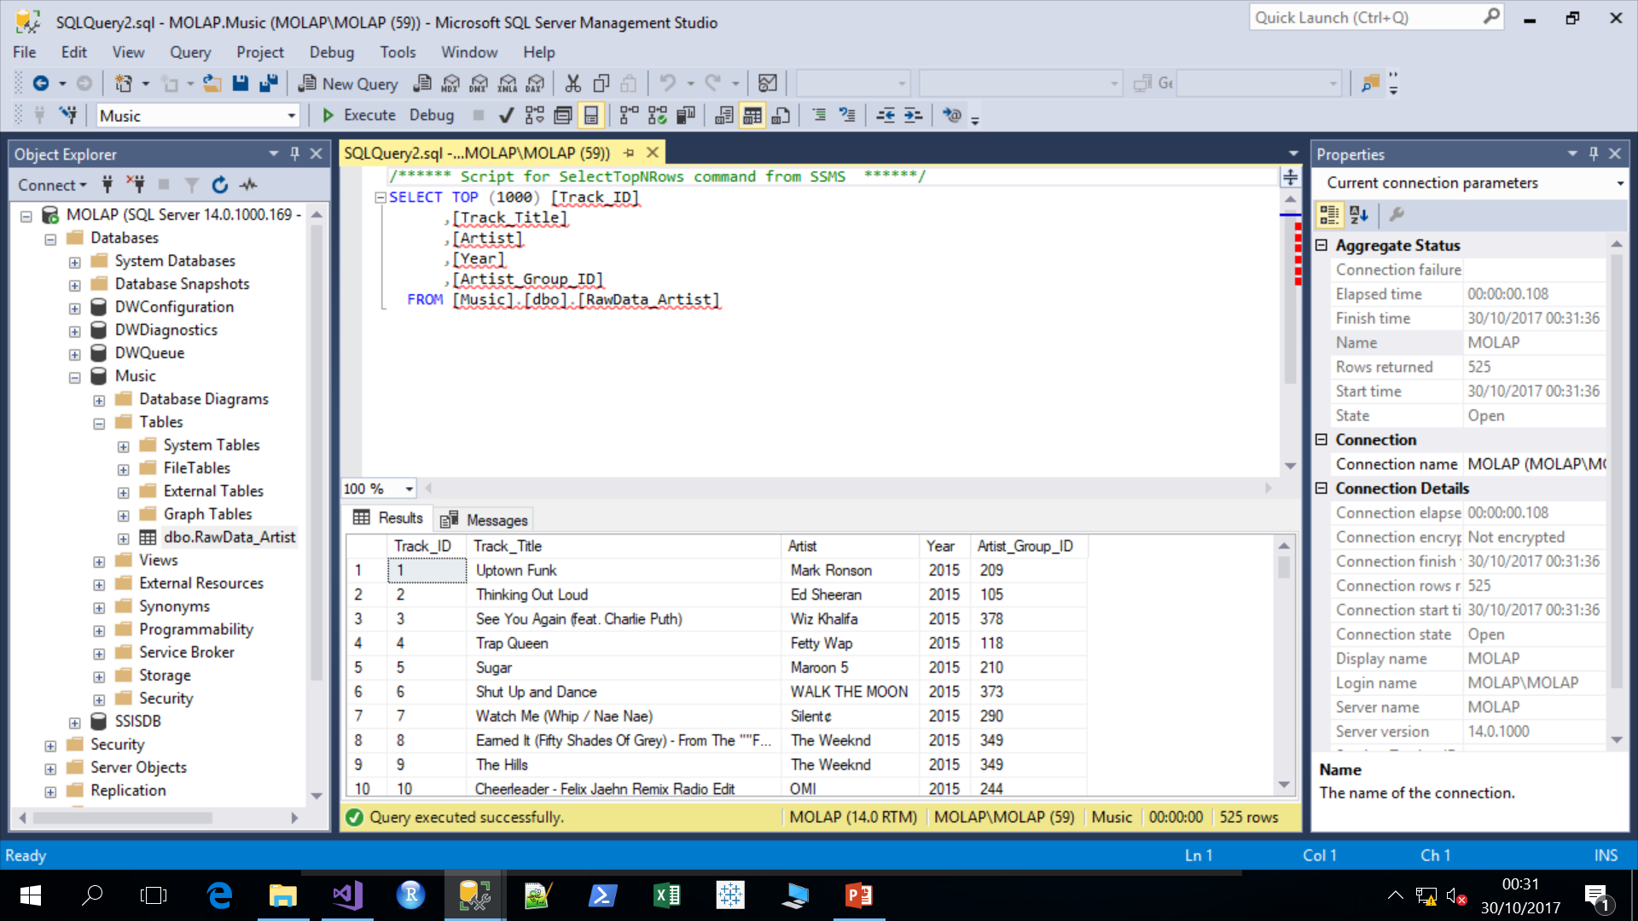
Upload data using SQL Server Management Studio Cont..
8. Right Click on Music database > Refresh
9. Expand Music > Expand Tables > Right Click on tables > Select Top 1000 rows

Slide 6
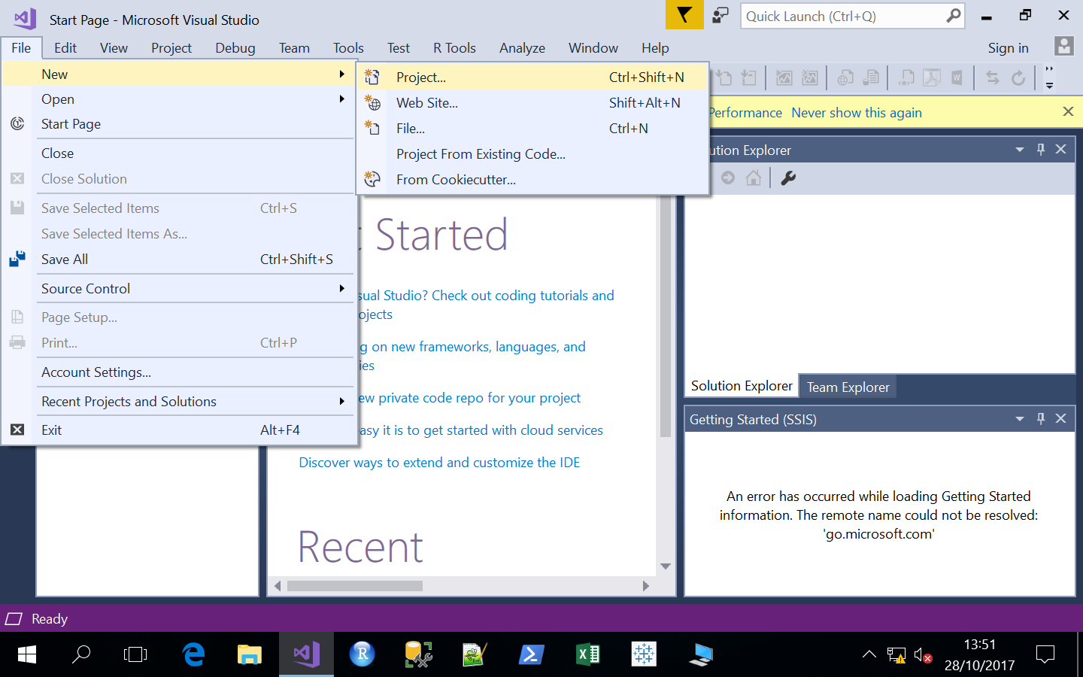
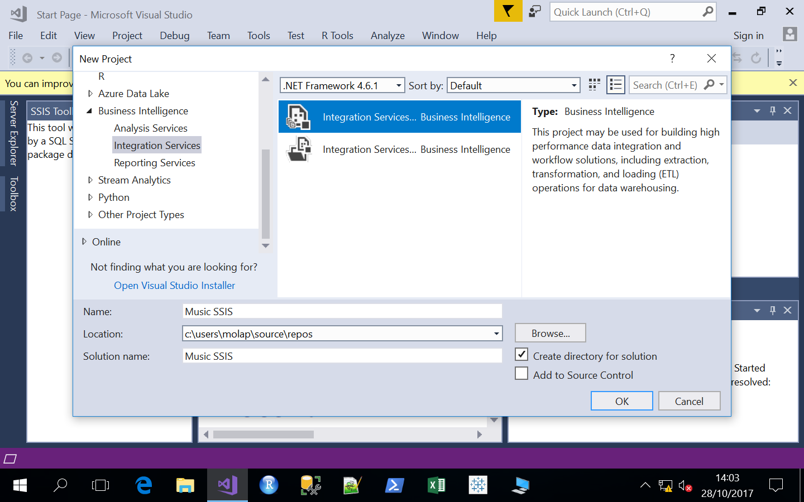
SQL Server Integration Services Tutorial
Open Visual Studio
Click New > Project
3. Expand Business Intelligence > Integration Services >
Integration Services > Rename the Project Name > OK

Slide 7
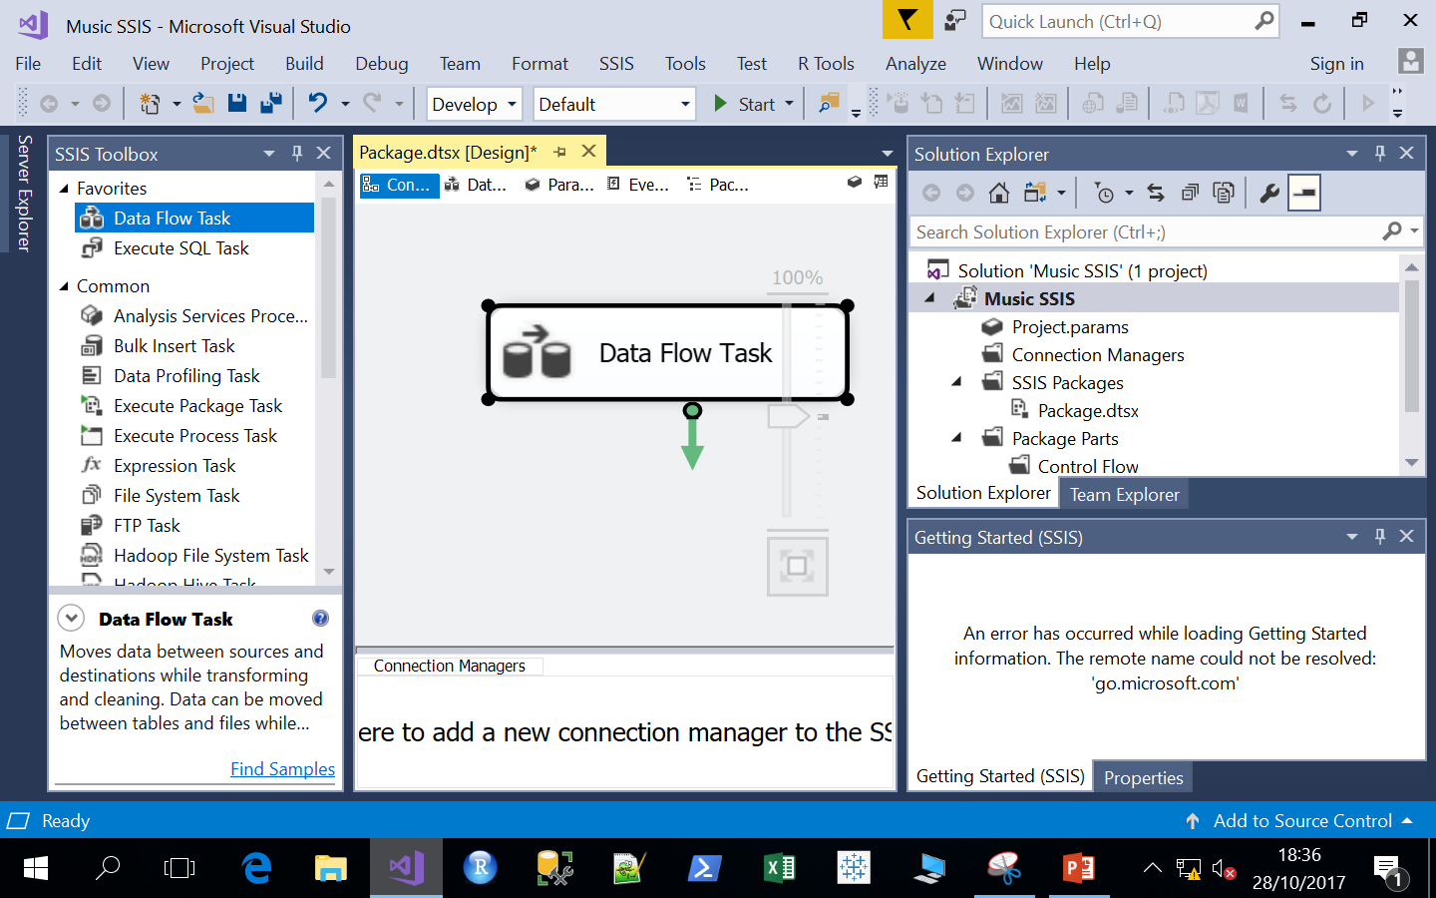
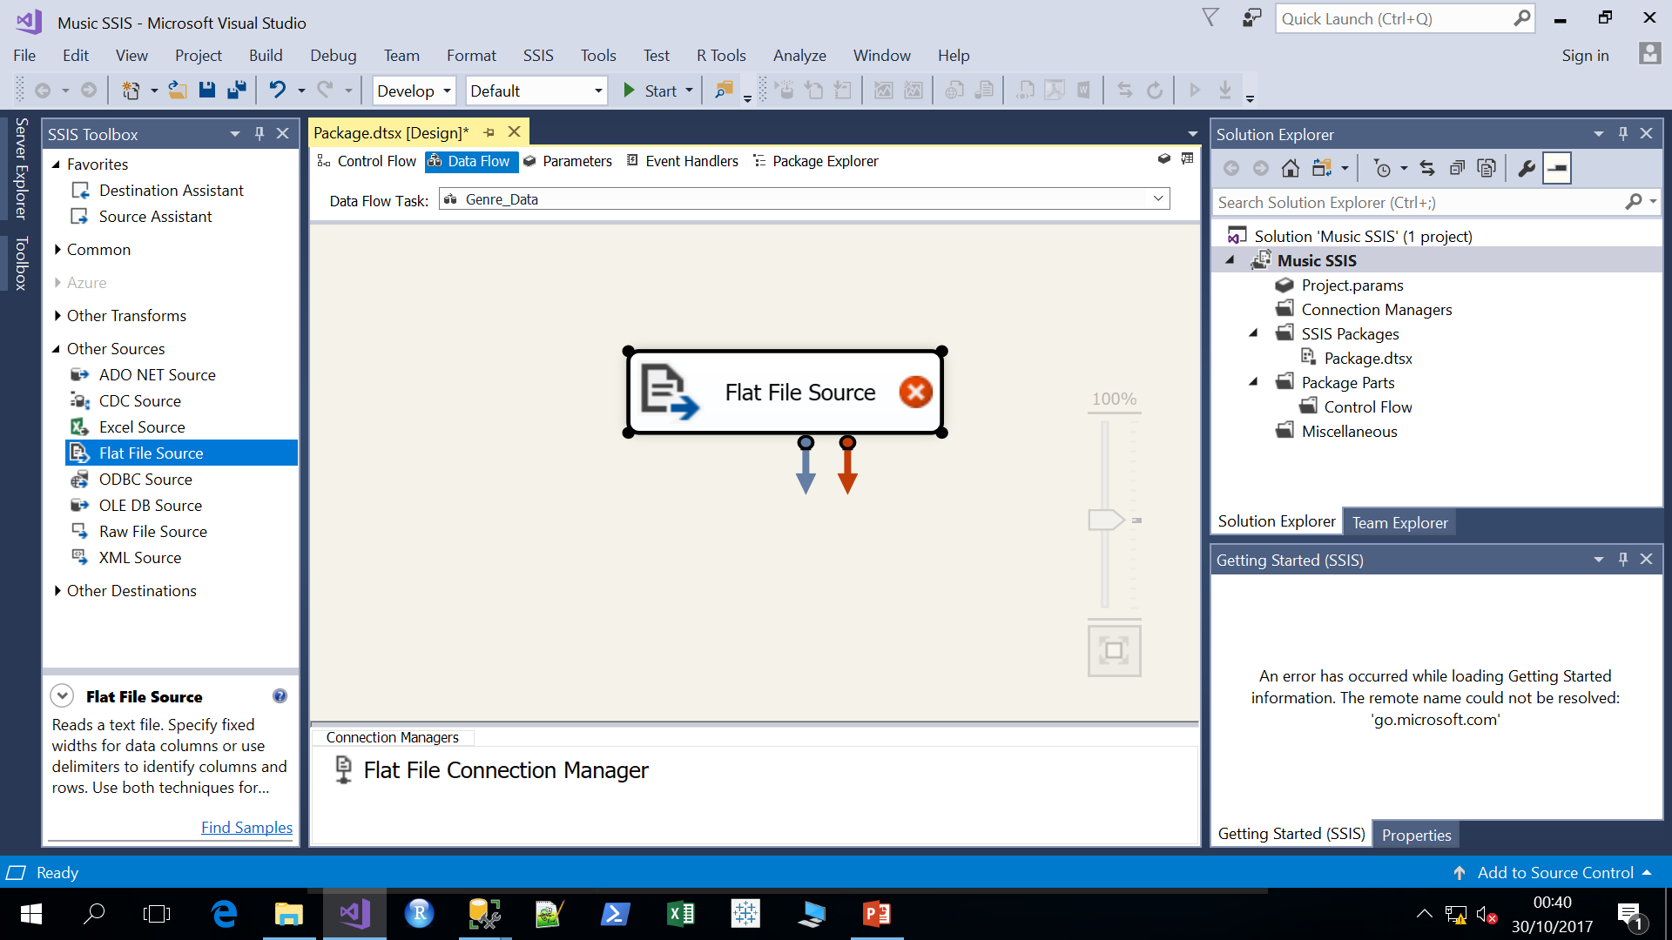
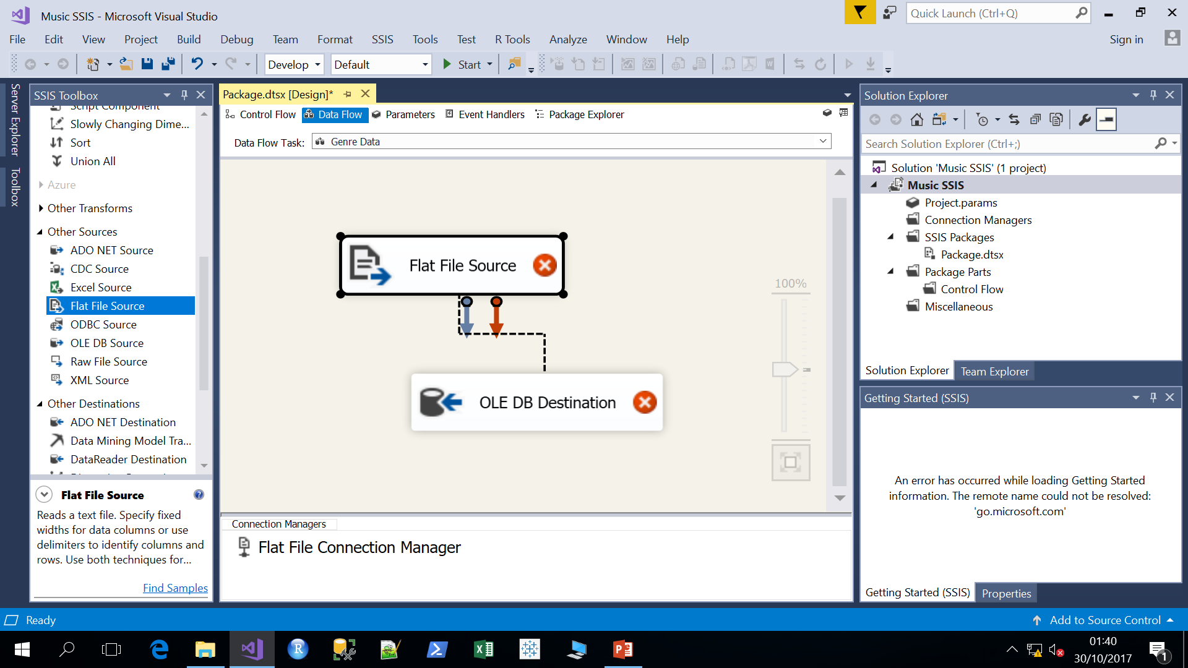
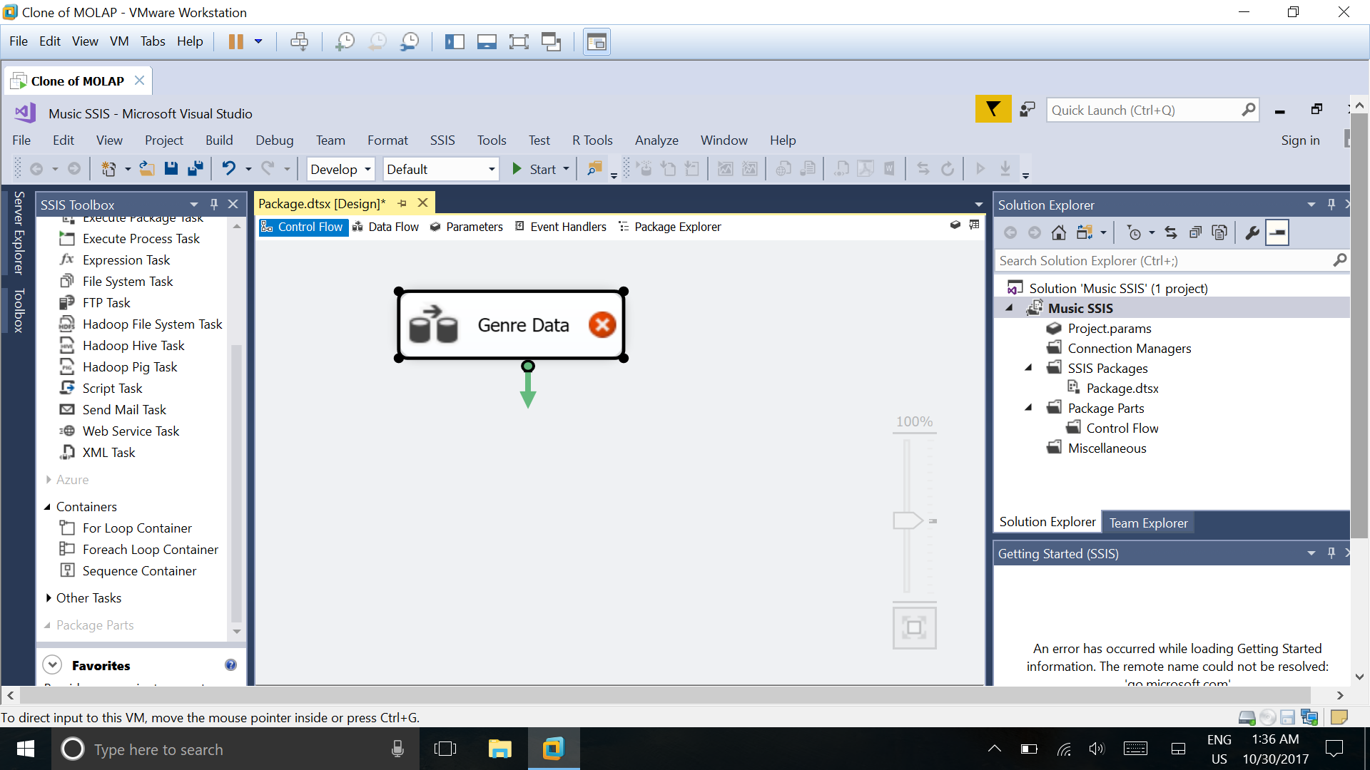
SQL Server Integration Services Tutorial Cont..
4. Drag Data Flow task into the Design area
Right Click on Data Flow Task Box > Rename
it as ‘Genre_Data‘
5. Double Click on Data flow task> Expand other
sources in SSIS tool box, drag Flat File source into
the design area
Data Source
6. Expand other
destination, drag OLEDB destination into the design area > Connect both flows with Blue arrow

Slide 8
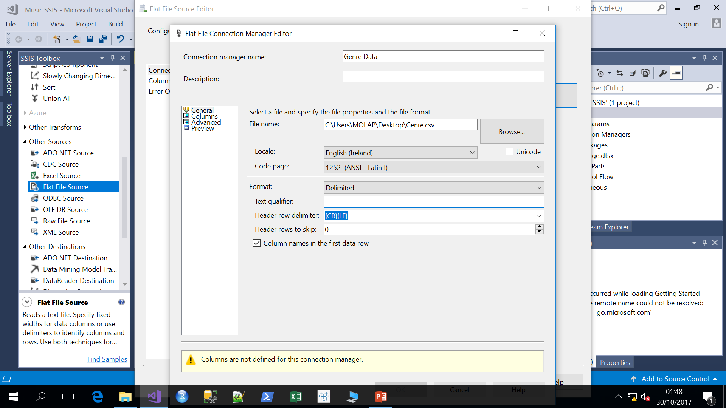
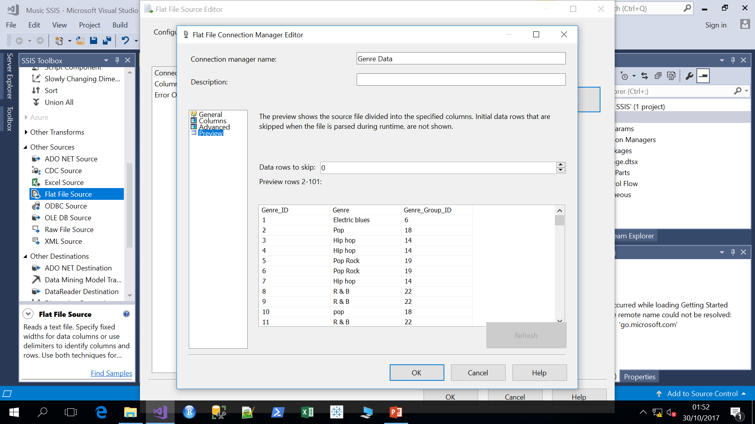
SQL Server Integration Services Tutorial Cont..
7. Double click on Flat File Source > New > Rename Connection Manager Name > Browse csv file location > Enter “ as text qualifier
8. Verify Columns tab, advanced tabs, Click on
Preview > OK

Slide 9
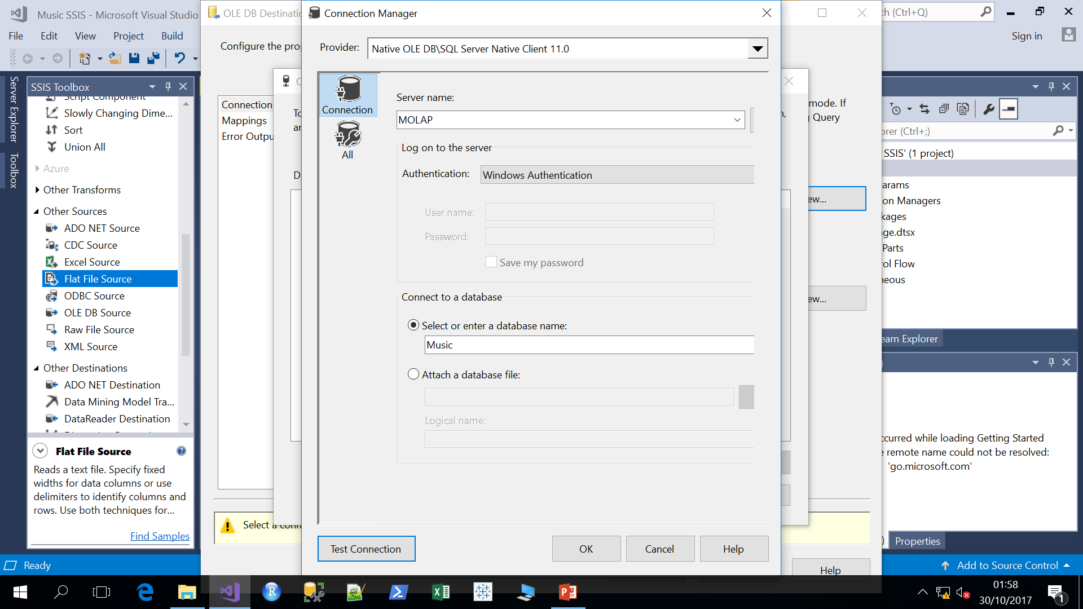
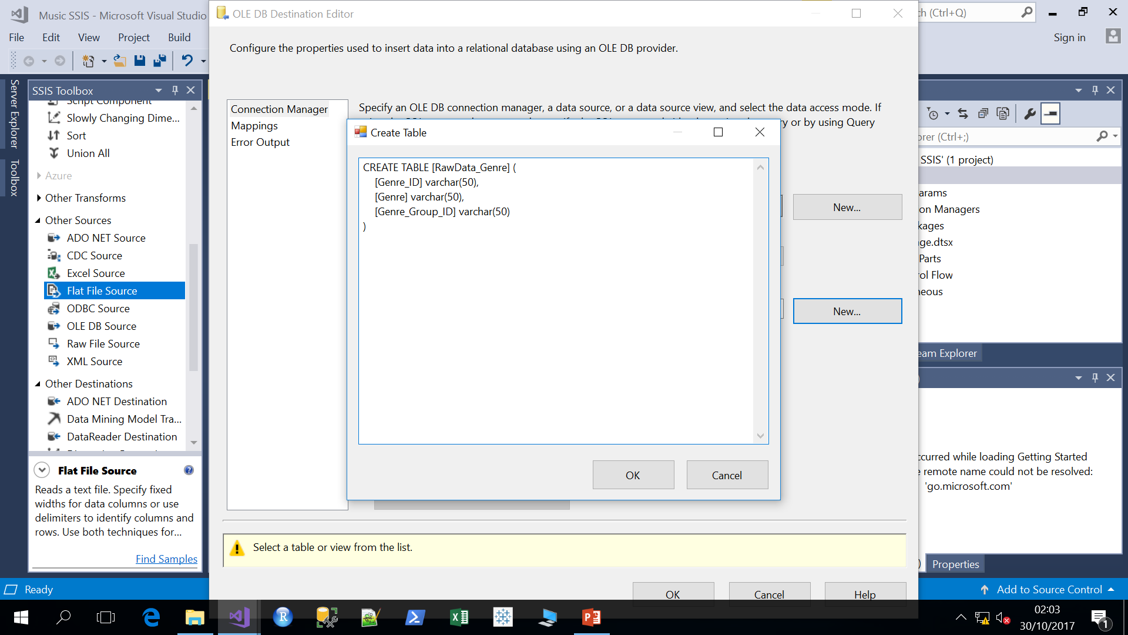
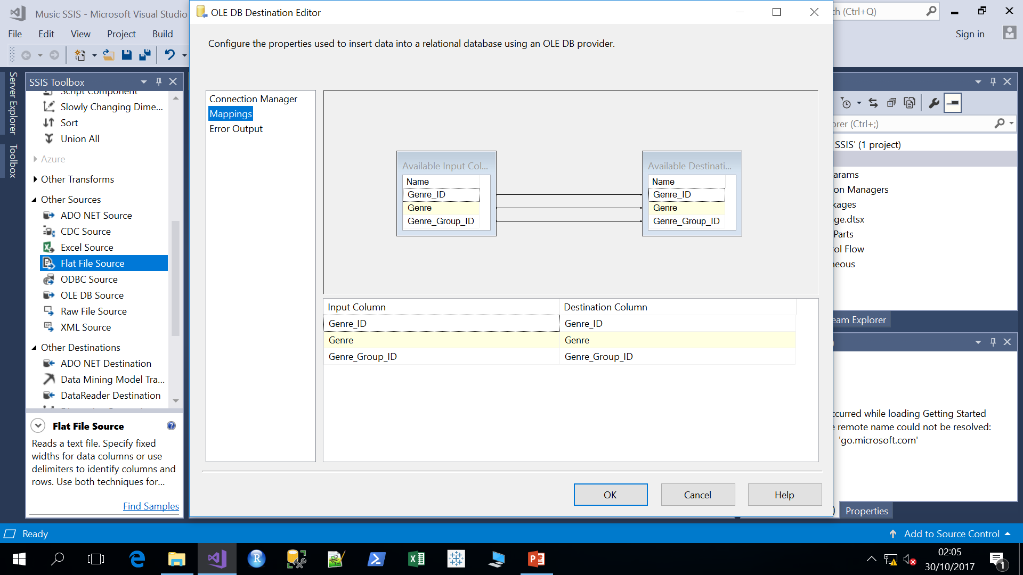
SQL Server Integration Services Tutorial Cont..
9. Double click on OLEDB Destination > New >New > Enter Server Name ‘MOLAP’ > Enter database name ‘Music’ > Test Connection > OK > OK
10. Click on New ‘Name of the table or view’ >
Edit the table name > OK
11. Click on Mappings
> OK

Slide 10
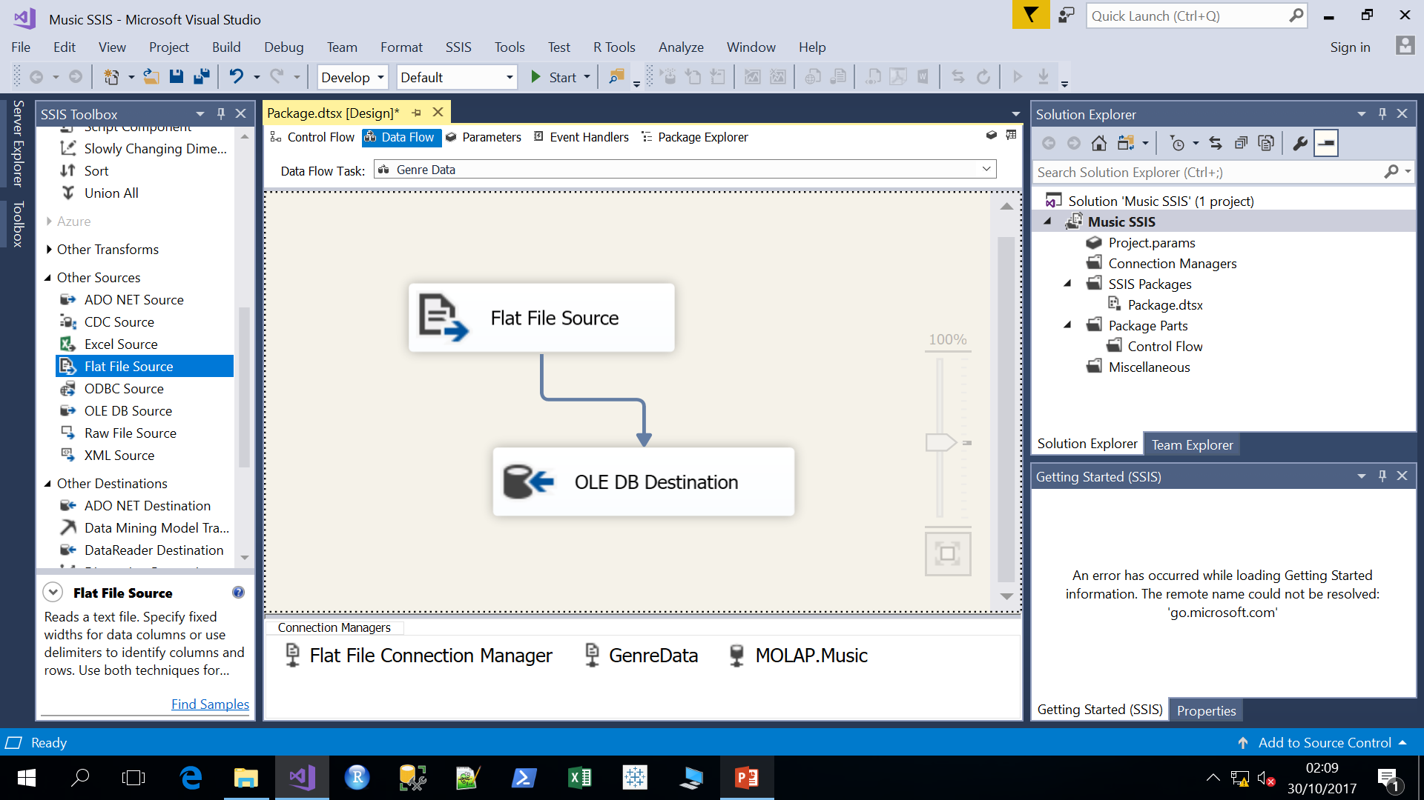
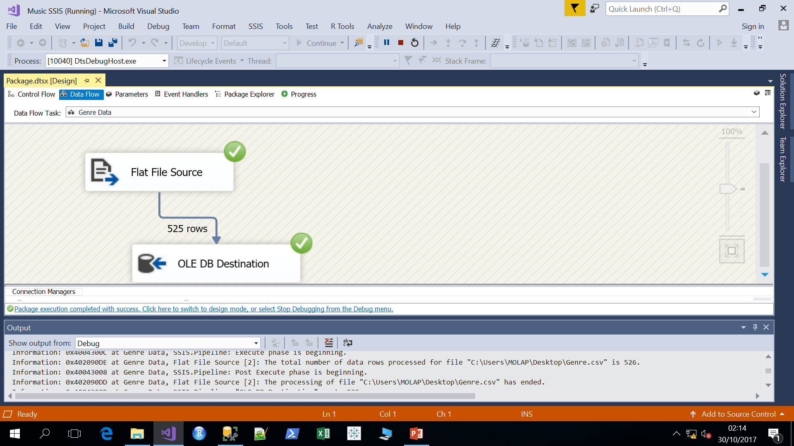
SQL Server Integration Services Tutorial Cont..
12. Click on Start and check package completion and execution success.

Slide 11
SQL Server Integration Services Tutorial Cont..
13. Check the data in SSMS and upload following data

